Slide 1


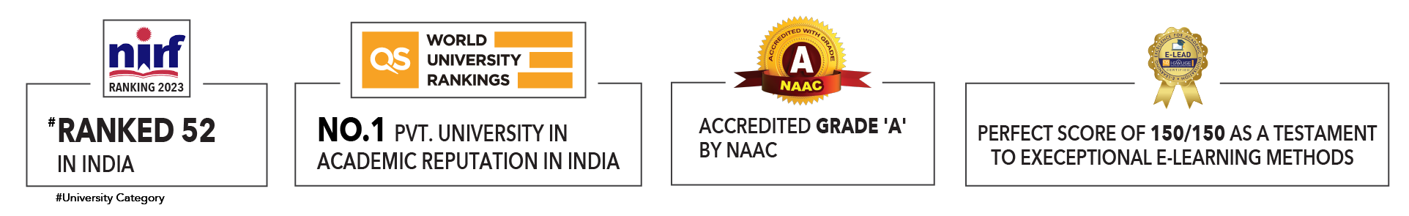

Slide 2

Unit 1 : Introduction to Operating System
Lecture 1
Dr. Hemant Petwal
School of Computer Science UPES, Dehradun
India

Slide 3
Table of Contents
Computer Hardware Review
Computer System
Introduction to Operating System
3.1. Definition
3.2. Operating System view

Slide 4
Learning & Course Outcomes
Learning Outcomes
LO1:Understand the functions of major computer hardware components
LO2: Define an operating system and identify its types and functions
Course Outcomes
CO1: Demonstrate a comprehensive understanding of operating systems

Slide 5
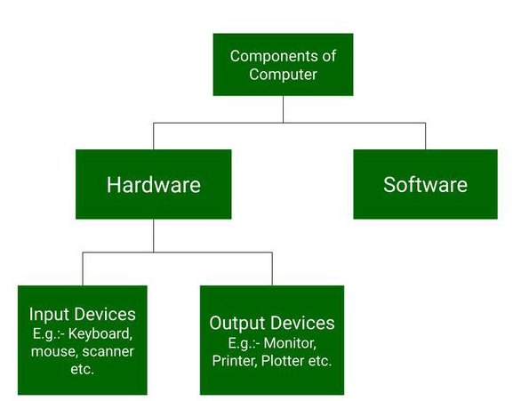
Computer Hardware Review
Computer hardware includes the physical parts of a computer, such as a Cabinet, central processing unit (CPU), random access memory (RAM), monitor, and mouse which processes the input according to the set of instructions provided to it by the user and gives the desired output.
A Computer is comprised of two major components
Hardware
Software
Fig 1. Components of Computer

Slide 6
Computer Hardware Review
Computer hardware is a physical device of computers that we can see and touch.
Hardware Components
Monitor
Central Processing Unit
Mouse
Joystick
Etc
Fig 2. Hardware Components
Using these devices, we can control computer operations like input and output. These hardware components are further divided into the following categories:
Hardware Categories
Input Devices
Output Devices
Storage Devices
Internal Components
Fig 3. Hardware Categories

Slide 7

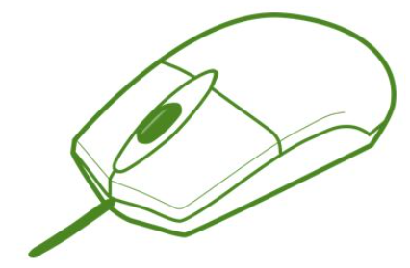

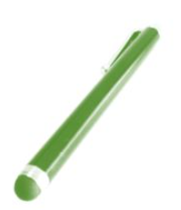
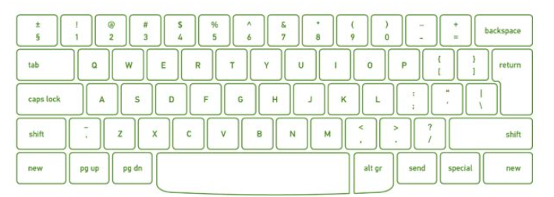
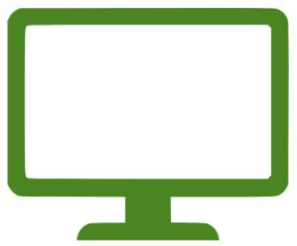
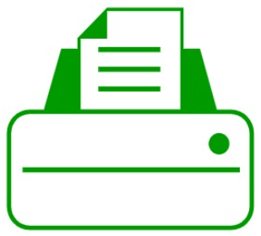

Computer Hardware Review
Input Devices
Input devices are those devices with the help of which the user interacts with the computer.
Keyboard
Mouse
Scanner
Light Pen
Bar Code Reader
etc.
Keyboard
Mouse
Scanner
Light Pen
Bar Code Reader
Fig 4. Input Devices
Output Devices
These are the devices that are used to display the output of any task given to the computer in human-readable form.
Monitor
Printer
Speaker
etc.
Monitor
Printer
Speaker
Fig 5. Output Devices

Slide 8
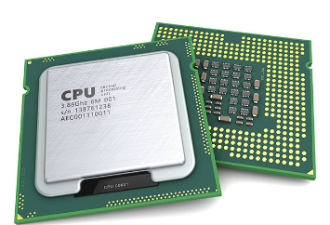
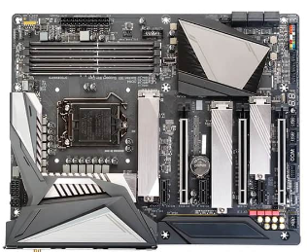
Computer Hardware Review
Internal Components
CPU (Central Processing Unit): Its also known as the heart of the computer. It consists of three units, generally known as the control unit, Arithmetic Logical Unit (ALU), and the memory unit.
Mother Board: It contain the main circuit board inside a computer and contains most of the electronic components together. All the components of the computer are directly or indirectly connected to the motherboard. It includes RAM slots, controllers, system chipsets etc.
Fig 6. Central Processing Unit
Fig 7. Mother Board

Slide 9
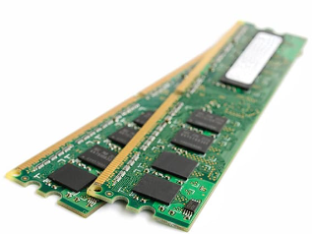
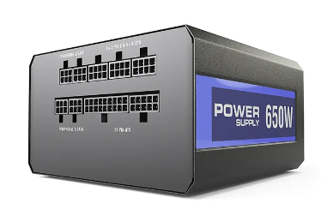
Computer Hardware Review
Internal Components
3. RAM (Random Access Memory): It is also known as temporary or volatile memory. It holds the program and data, which are currently in process or processing.
4. Power Supply
All of a computer system’s parts are powered by a power source. Typically, a power cord is used to connect a computer tower to an electrical outlet.
Fig 8. Random Access Memory
Fig 9. Power Supply

Slide 10
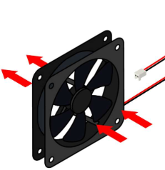
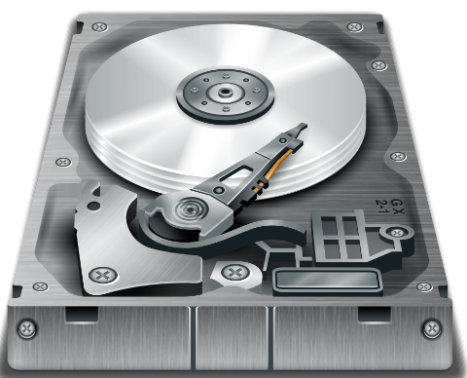
Computer Hardware Review
Internal Components
5. Cooling Fan
A computer’s system to prevent overheating uses cooling fans. To aid customers who use their computers intensively, such as when streaming video or playing games, many computers contain more than one cooling fan.
6. Hard Drive
On a computer system, files, programs, and other types of information are stored on hard drives, which are data storage devices. They utilise hard drives, which are magnetically coated discs used to store digital versions of information. A computer technician can suspect a corrupt hard disk when a hard drive dies.
Fig 10. Cooling Fan
Fig 11. Hard Disk

Slide 11
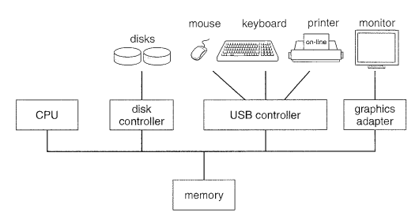
Computer System
Computer system consists of hardware components that have been carefully chosen so that they work well together and software components or programs that run in the computer.
The main software component is itself an operating system (OS) that manages and provides services to other programs that can be run in the computer.
In its most basic form, a computer system is a programmable electronic device that can accept input; store data; and retrieve, process and output information.
Fig 12. A modern computer system.

Slide 12
Introduction to Operating System: Definition
Operating system can be defined in several ways:
An Operating System (OS) is a system software which is a collection of software that manages computer hardware resources and provides common services for computer programs. The operating system is the most important type of system software in a computer system.
An operating system is like a bridge between your computer’s hardware and the programs you use. It makes sure that your computer’s memory, CPU, and storage are used effectively while running.
Operating System is a fully integrated set of specialized programs that handle all the operations of the computer. It controls and monitors the execution of all other programs that reside in the computer, which also includes application programs and other system software of the computer. Examples of Operating Systems are Windows, Linux, Mac OS, etc.

Slide 13
Operating System: View
An operating system can be defined or observed in two ways
User View
System View
User View
The user viewpoint focuses on how the user interacts with the operating system through the usage of
various application programs. In contrast, the system viewpoint focuses on how the hardware interacts
with the operating system to complete various tasks.
Single User Viewpoint
User Viewpoint
Multiple User Viewpoint
Handled User Viewpoint
Embedded User Viewpoint

Slide 14
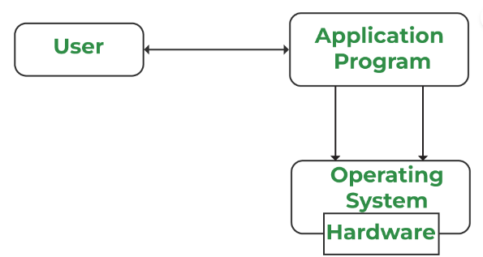
Operating System: User Viewpoint
Single User Viewpoint
These systems are designed for a single user experience and meet the needs of a single user
The performance is not given focus as the multiple user systems.
Fig 13. Single User Viewpoint

Slide 15
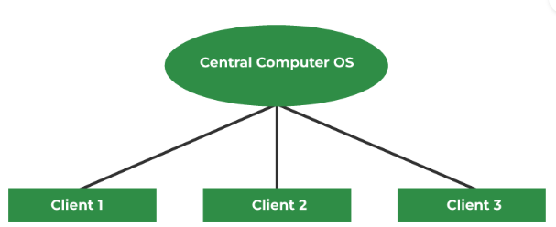
Operating System: User Viewpoint
Multiple User Viewpoint
These systems consists one mainframe computer and many users on their computers trying to interact with their kernels over the mainframe to each other.
In such systems, memory allocation by the CPU must be done effectively to give a good user experience.
The client-server architecture is another good example where many clients may interact through a remote server
Fig 14. Multiple User Viewpoint

Slide 16
Operating System: User Viewpoint
Handled User Viewpoint
These systems are lies under touchscreen era that comes with best handheld technology ever. Smartphones interact via wireless devices to perform numerous operations,
Such operating system is a great example of creating a device focused on the user's point of view.
Embedded User Viewpoint
Systems in which remote control used to turn on or off the tv is all part of an embedded system in which the electronic device communicates with another program where the user viewpoint is limited and allows the user to engage with the application.

Slide 17
Operating System: View
An operating system can be defined or observed in two ways
User View
System View
System View
A computer system comprises various sources, such as hardware and software, which must be managed effectively. The operating system manages the resources, decides between competing demands, controls the program execution, etc.
According to this point of view, the operating system's purpose is to maximize performance. The operating system is responsible for managing hardware resources and allocating them to programs and users to ensure maximum performance.
Resource Allocation
System Viewpoint
Control Program

Slide 18
Operating System: System Viewpoint
From a system viewpoint, the hardware interacts with the operating system than with the user. The hardware and the operating system interact for a variety of reasons, including:
Resource Allocation
The hardware contains several resources like registers, caches, RAM, ROM, CPUs, I/O interaction, etc. These are all resources that the operating system needs when an application program demands them.
Only the operating system can allocate resources with several tactics and strategies to maximize its processing and memory space. The operating system uses a variety of strategies to get the most out of the hardware resources, including paging, virtual memory, caching, and so on.
Control Program
The control program controls how input and output devices (hardware) interact with the operating system.
The user may request an action that can only be done with I/O devices; in this case, the operating system must also have proper communication, control, detect, and handle such devices.

Slide 19
MCQ
Q1. Which of the following is NOT an input device?
A. Keyboard B. Mouse
C. Monitor D. Scanner
Q2. What is the main function of the CPU in a computer system?
A. To display output B. To manage software resources
C. To process input according to instructions D. To store data permanently
Q3. The component that holds most of the electronic components together and connects all parts of the computer is called:
A. Hard Drive B. Motherboard
C. Power Supply D.RAM
Q4. RAM is classified as which type of memory.
A. Permanent B. Volatile
C. Non-volatile D. External

Slide 20
MCQ
Q5. The primary function of an operating system is to:
A. Manage computer hardware resources B. Provide antivirus protection
C. Design graphics D. Develop software
Q6. An operating system that allows multiple users to interact with a mainframe computer is an example of:
A. Single User System B. Multiple User System
C. Handled User System D. Real-Time System
Q7. The user viewpoint of an operating system focuses on:
A. How hardware interacts with the OS B. How the user interacts with application programs
C. Resource allocation D. Control program functions
Q8. The operating system uses strategies like paging and virtual memory for:
A. Resource allocation B. Managing user interfaces
C. Controlling I/O devices D. Executing application programs

Slide 21
MCQ: Answers
Question No- Answers | Option | Description
Q1- Answer | C | Monitor
Q2- Answer | C | To process input according to instructions
Q3- Answer | B | Motherboard
Q4- Answer | B | Volatile
Q5- Answer | A | Manage computer hardware resources
Q6- Answer | B | Multiple User System
Q7- Answer | B | How the user interacts with application programs
Q8- Answer | A | Resource allocation

Slide 22
Summary/Key Points
Computer hardware includes the physical parts of a computer, such as a Cabinet, central processing unit (CPU), random access memory (RAM) etc.
Computer Hardware is categorized into 4 categories i.e., Input Devices, Output devices, Storage Device, Internal Components
Computer system consists of hardware components that have been carefully chosen so that they work well together and software components or programs that run in the computer.
An Operating System (OS) is a system software which is a collection of software that manages computer hardware resources and provides common services for computer programs. The operating system is the most important type of system software in a computer system.
An operating system can be defined two ways: User View & System View

Slide 23
Reference Material
Operating Systems Concepts (10th Ed.) Silberschatz A, Peterson J and Galvin P, John Wiley & Sons, Inc. 2018.
Computer Hardware Review, Page No: 1-3
Computer System, Page No: 3-4
Operating system view, Page No: 3-4
Modern Operating Systems (4th Ed.) by Andrew S. Tanenbaum and Herbert Bos, 2007
Operating Systems: Principles and Practice by Thomas Anderson and Michael Dahlin, 2014

Slide 24
Coming Up-Next Lecture
History of Operating System
Types of Operating Functions of Operating System

Slide 25

Thank You

